Slide 1
Sompo GROUP 1
Name : Xuan Anh
Thanh Tam

Slide 2
JAVA fresher: Project Assignment
Table of contents
1. Structure
2. Bussiness (Flowchart Diagram)
3. Use Case Diagram
4. Database Diagram
5. Login page
6. Client Maintenance Submenu
Create Client
Modify Client
Inquire Client
Delete Client
7. Search Client Scroll
8. Batch extract client information

Slide 3
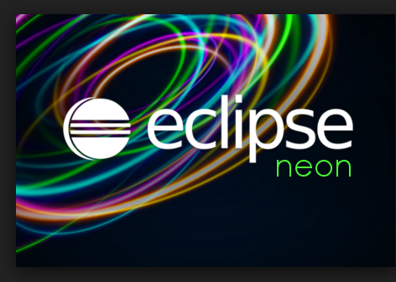
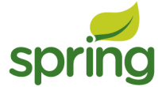
Tool IDE

Slide 4
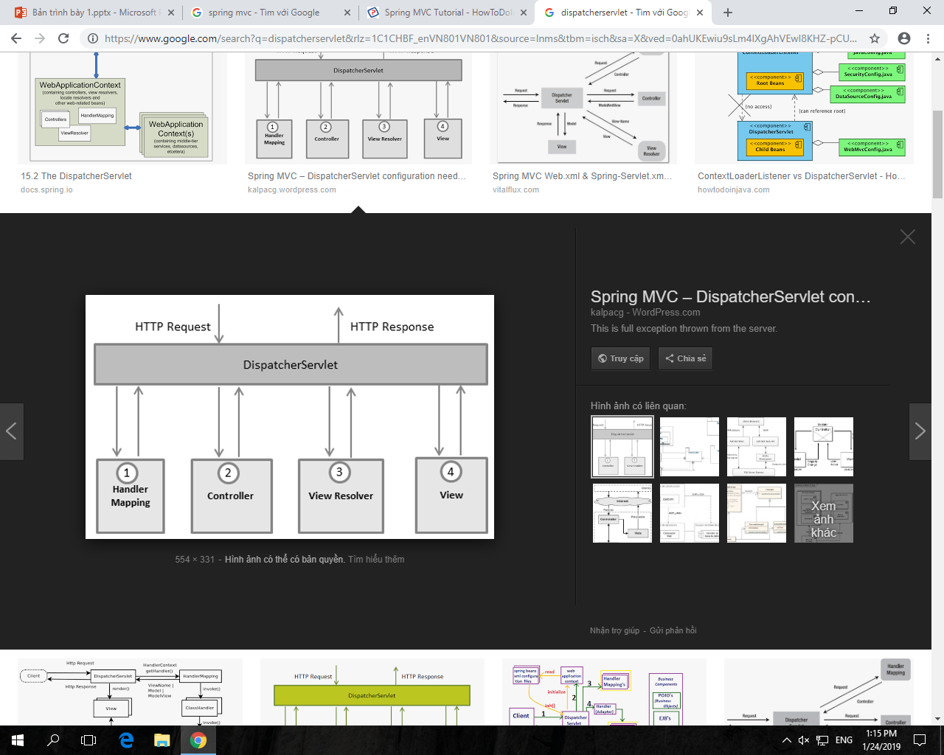
Spring MVC workflow

Slide 5
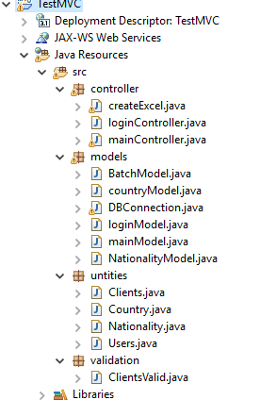


structure
Controller classes
DAO implementation classes
Model or Entity Bean
Validation classes

Slide 6
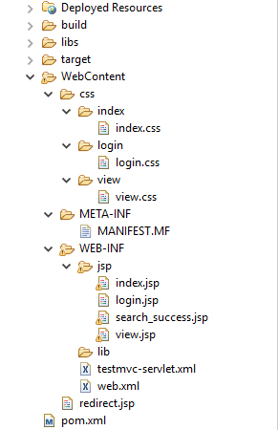
structure
CSS
View pagers
Deployment Descriptor
Maven Dependencies

Slide 7
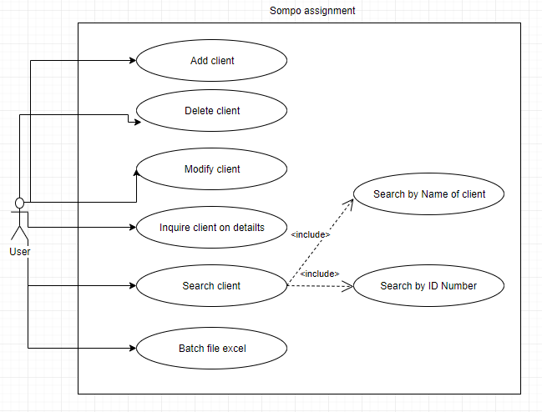

Use case diagram

Slide 8
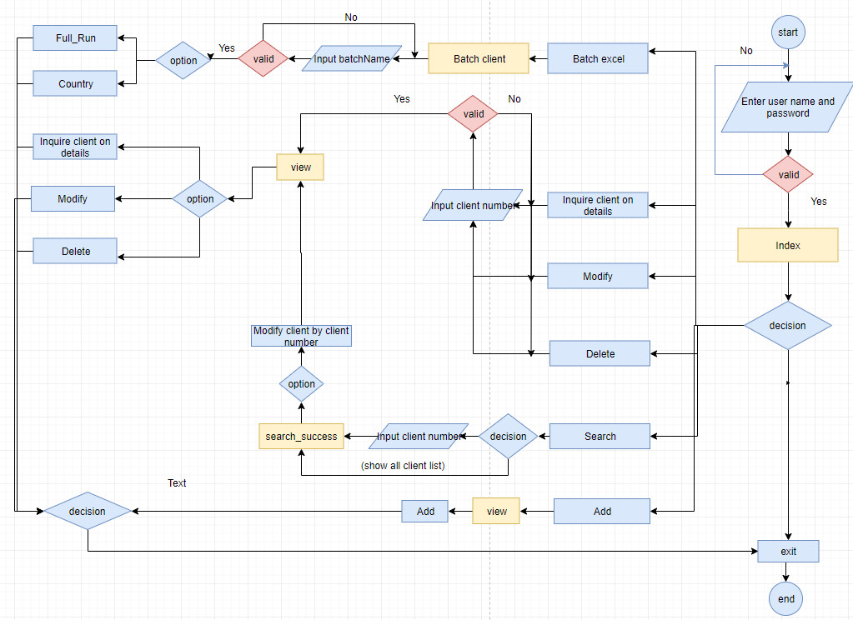
bussiness

Slide 9
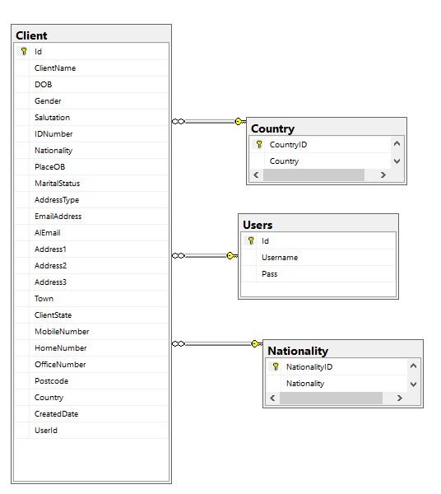
Database diagram

Slide 10
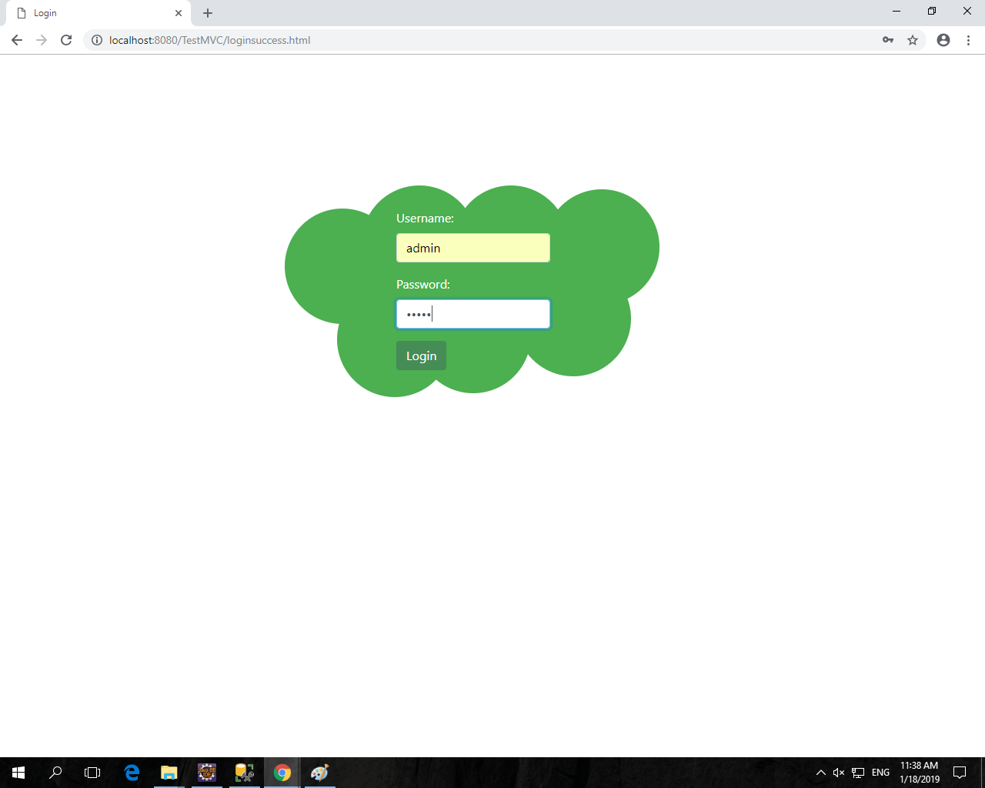
Login page

Slide 11
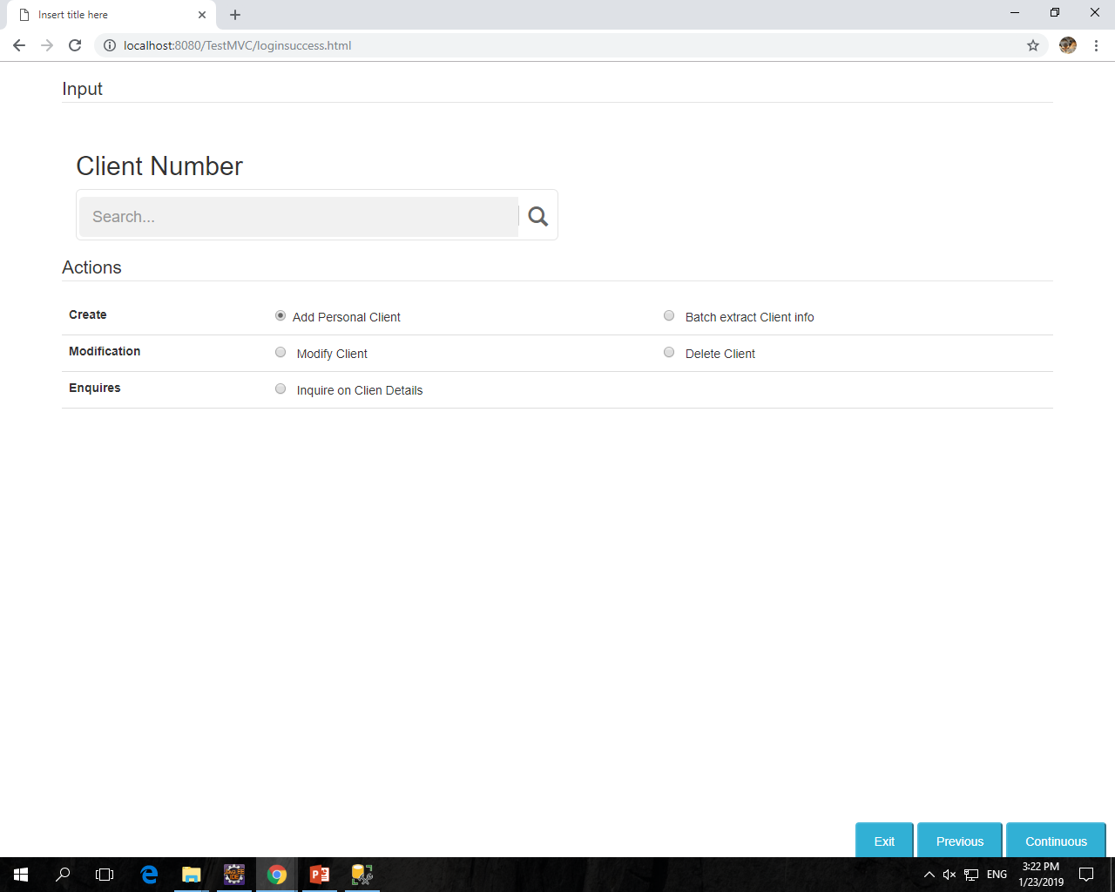
Client Maintenance Submenu

Slide 12
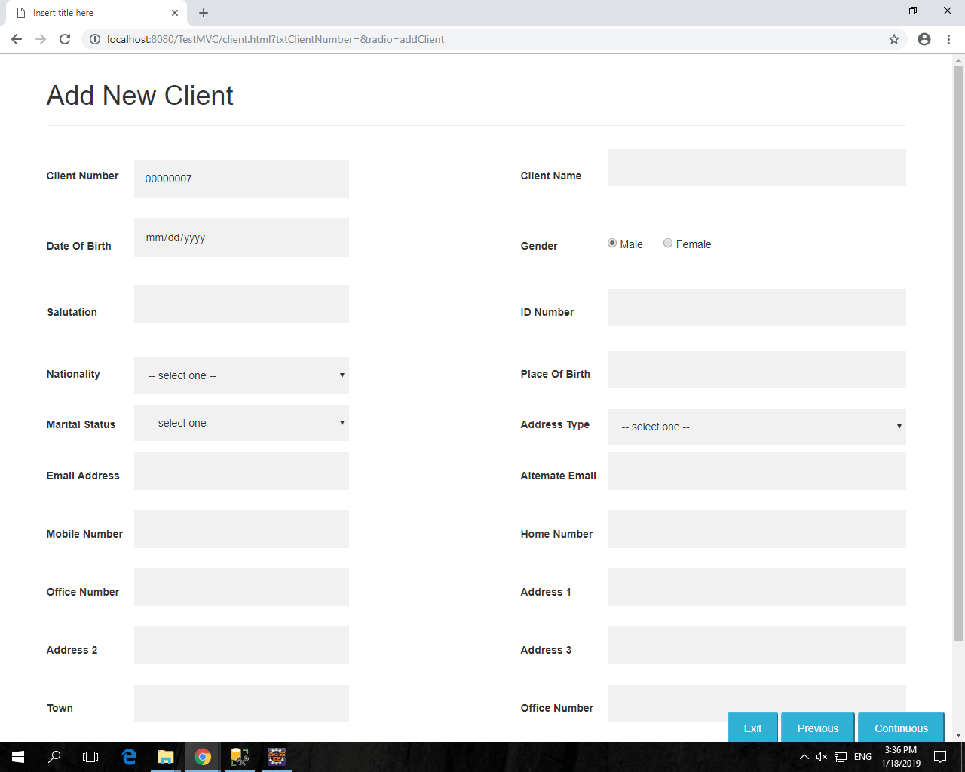
Client Maintenance Submenu
- Create client.

Slide 13
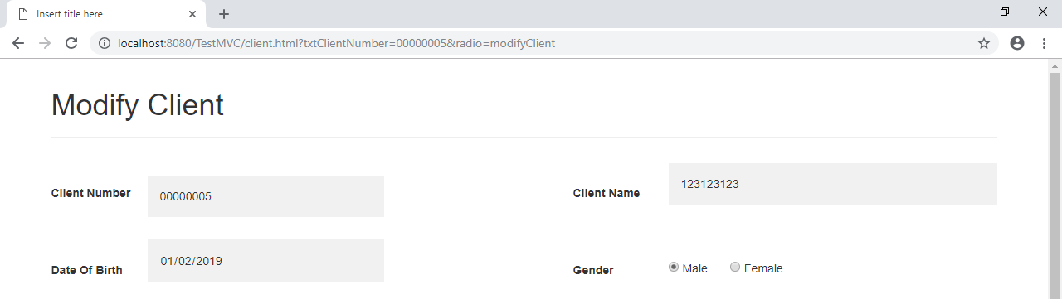
Client Maintenance Submenu
- Modify client.

Slide 14
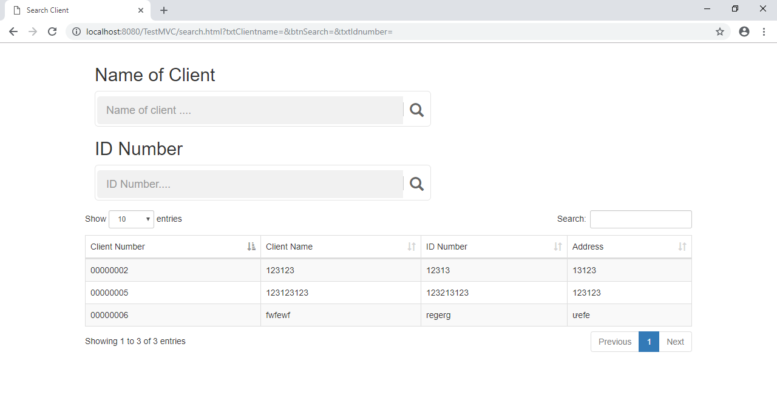
Search Client Scroll

Slide 15
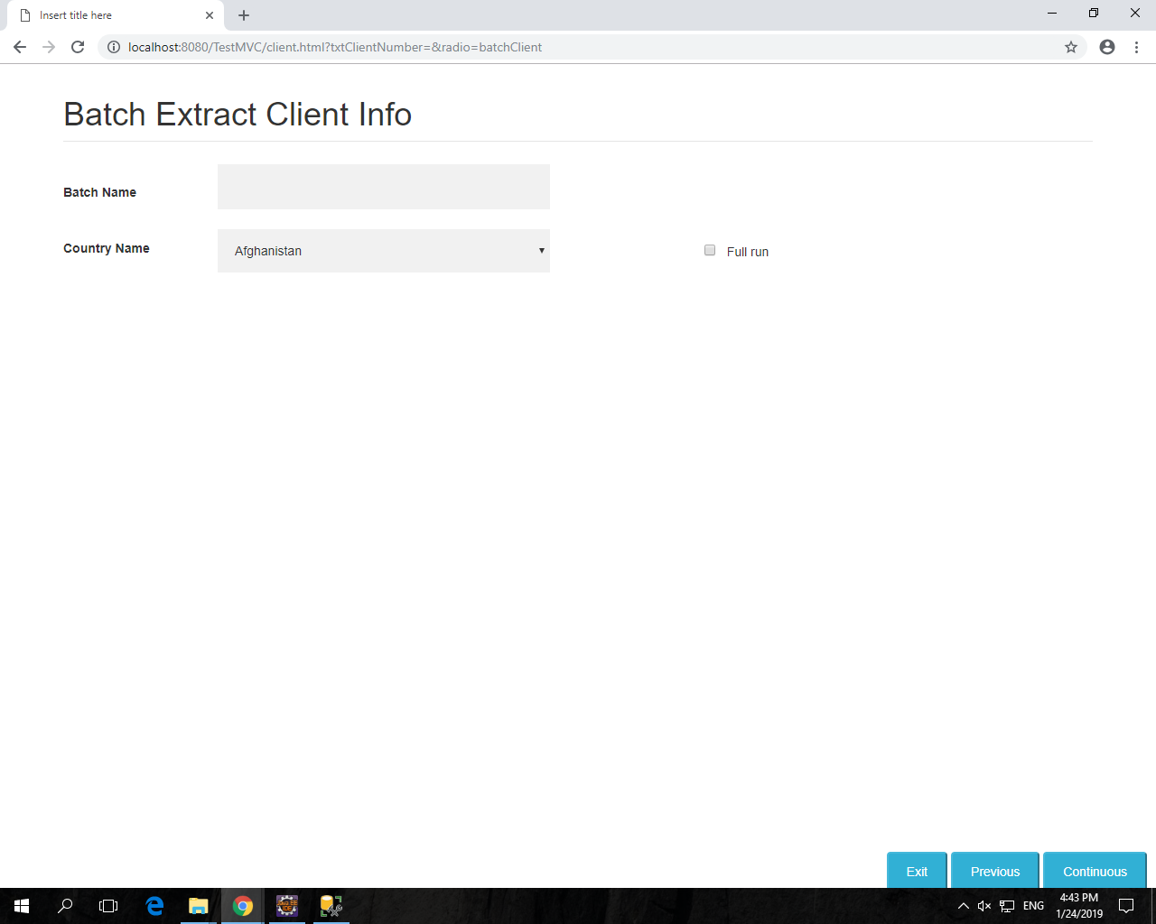
Batch extract client ifno

Slide 16
Question and answer

Slide 17
Thank you for your attention

